Slide 1
Events in protein folding

Slide 2
Introduction
Many proteins take at least a few seconds to fold, but almost all proteins undergo major structural transitions within the first millisecond (ms) of folding.
A specific structure also appears to form within the first millisecond.
When studied at the first ms of folding, the compact globule appears to be a specific folding intermediate.
The accumulated kinetic data suggest that structure formation in the first ms may be highly non-cooperative and may occur in many steps

Slide 3
Levinthal Paradox
A polypeptide chain of 101 amino acid residues would have to sample 3¹⁰⁰ = 5 × 10⁴⁷ conformations, if each bond connecting two consecutive residues has only three possible configurations.
If the sampling takes place at a rate equal to that of bond vibrations, i.e. 10¹³ s^{–1}, then it would take 10²⁷ years for an unfolded polypeptide chain to complete the search for its native conformation.
The discrepancy between this large time estimate and the real folding times of proteins, which are in the seconds timescale or faster, is commonly referred to as the Levinthal paradox

Slide 4
Challenges
A major recent thrust of protein-folding research has been the identification of downhill folding scenarios predicted by the energy landscape view of protein folding.

Slide 5
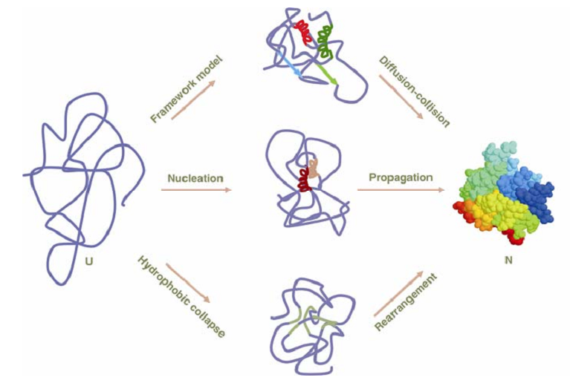
How do proteins fold?

Slide 6
Different models
The framework model | hydrophobic collapse | The nucleation model
Protein folding stages: Local interactions Random diffusion–collision of these local elements of the secondary structure Stable native tertiary contacts | Protein folding stages: Entropically driven clustering of the hydrophobic amino acid residues Restricted conformational space facilitates the formation of the secondary structure Consolidation of tertiary contacts. | Protein folding stages: Formation of a local nucleus of the secondary structure by a few key residues in the polypeptide chain. The rest of the structure then propagates around the nucleus without encountering any energy barrier

Slide 7
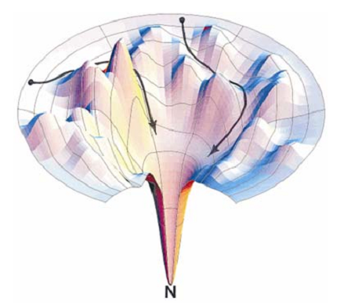
Energy landscape view of protein folding
Recent view: protein folding mechanism according to the energy landscape model
According to this model, all folding protein molecules are guided by an energy bias to traverse an energy landscape towards the native conformation.

Slide 8
Special concern
The folding reaction is expected to be cooperative, which implies that the detection of intermediate conformations
The folding kinetics of many other proteins is multi-exponential, which implies that intermediates populate the folding pathways of these proteins
Protein folding can be cooperative

Slide 9
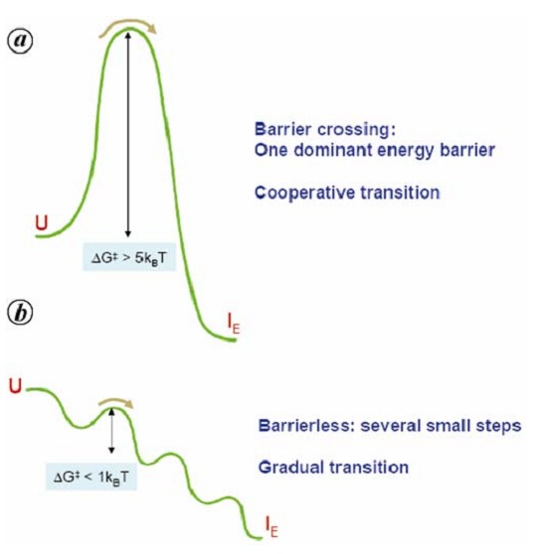
Energy surface for protein folding scenarios. (a) two-state (b) downhill protein folding scenarios.
early folding intermediate I_{E},
k_{B} is Boltzmann constant;
k_{B}=1.3806503 × 10⁻²³ m² kg s⁻² K⁻¹

Slide 10
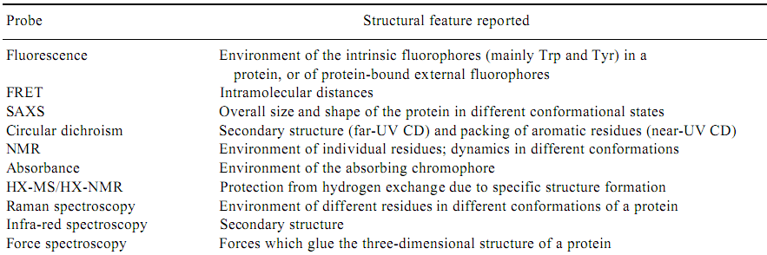
Physical measures of protein folding

Slide 11
FRET: Förster resonance energy transfer (abbreviated FRET), also known as fluorescence resonance energy transfer, resonance energy transfer (RET) or electronic energy transfer (EET), is a mechanism describing energy transfer between two chromophores.
Circular dichroism (CD): refers to the differential absorption of left and right circularly polarized light
Small-angle X-ray scattering (SAXS): the advantage of SAXS over crystallography is that a crystalline sample is not needed.
Amide Hydrogen Exchange (HX), Hydrogen Exchange and Mass Spectrometry

Slide 12
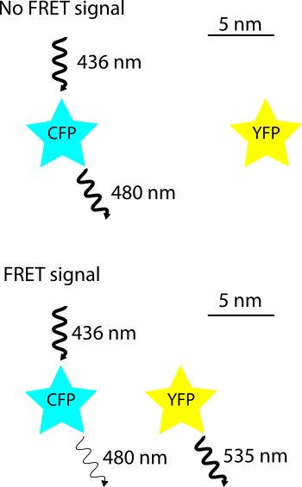

Slide 13
Values of the hydrophobicity parameter assigned to each amino acid according to the fuzzy-oil-drop model.

